Slide 1
Software Engineering I
Dr. Elham Mahmoudzadeh
Isfahan University of Technology
mahmoudzadeh@iut.ac.ir
2021

Slide 2
Chapter 7 Moving To Design

Slide 3
Steps(I)
Preparing proposal
Requirements determination
User story
Abstract Business Process Modelling
Analysis
Functional Modelling
Structural Modelling
Behavioral Modelling

Slide 4
Steps(II)
Design
Optimization
Database Management
User Interface
Physical Architecture

Slide 5
Is the current representation of the evolving system optimal?
A good design is one that balances trade-offs to minimize the total cost of the system over entire life time.

Slide 6
What is design?
Design is what almost every engineer wants to do.
It is the place where creativity rules—where stakeholder requirements, business needs, and technical considerations all come together in the formulation of a product or system.
Creates a representation or model of the software, but unlike the requirements model (that focuses on describing required data, function, and behavior), the design model provides detail about software architecture, data structures, interfaces, and components that are necessary to implement the system.
This slide is brought from: “R.G. Pressman, B. R. Maxim, Software Engineering_ A Practitioner’s Approach, 8th Edition, 2014”.

Slide 7
Why is Design important?
Design allows you to model the system or product that is to be built.
This model can be assessed for quality and improved before code is generated, tests are conducted, and end users become involved in large numbers.
Design is the place where software quality is established.
This slide is brought from: “R.G. Pressman, B. R. Maxim, Software Engineering_ A Practitioner’s Approach, 8th Edition, 2014”.

Slide 8
How do I ensure that I’ve done it right?
The design model is assessed by the software team in an effort to determine whether it contains errors, inconsistencies, or omissions; whether better alternatives exist; and whether the model can be implemented within the constraints, schedule, and cost that have been established.
This slide is brought from: “R.G. Pressman, B. R. Maxim, Software Engineering_ A Practitioner’s Approach, 8th Edition, 2014”.

Slide 9
Three important features of a good design
The Roman architecture critic Vitruvius advanced the notion that well-designed buildings were those which exhibited firmness, commodity, and delight. The same might be said of good software.
Firmness: A program should not have any bugs that inhibit its function.
Commodity: A program should be suitable for the purposes for which it was intended.
Delight: The experience of using the program should be a pleasurable one.
This slide is brought from: “R.G. Pressman, B. R. Maxim, Software Engineering_ A Practitioner’s Approach, 8th Edition, 2014”.

Slide 10
Two main steps
Diversification: is the acquisition of a repertoire of alternatives, the raw material of design: components, component solutions, and knowledge, all contained in catalogs, textbooks, and the mind.” Once this diverse set of information is assembled, you must pick and choose elements from the repertoire that meet the requirements defined by requirements engineering and the analysis model.
Convergence. As this occurs, alternatives are considered and rejected, and you converge on “one particular configuration of components, and thus the creation of the final product”.
This slide is brought from: “R.G. Pressman, B. R. Maxim, Software Engineering_ A Practitioner’s Approach, 8th Edition, 2014”.

Slide 11
Software design sits at the technical kernel of SE
and
is applied regardless of the software process model that is used.

Slide 12
Moving from Analysis to Design
Once software requirements have been analyzed and modeled, software design is the last software engineering action within the modeling activity and sets the stage for construction (code generation and testing).
Each of the elements of the requirements model provides information that is necessary to create design models required for a complete specification of design.
The requirements model feed the design task.
Using design notation and design methods, design produces a data/class design, an architectural design, an interface design, and a component design.
This slide is brought from: “R.G. Pressman, B. R. Maxim, Software Engineering_ A Practitioner’s Approach, 8th Edition, 2014”.

Slide 13
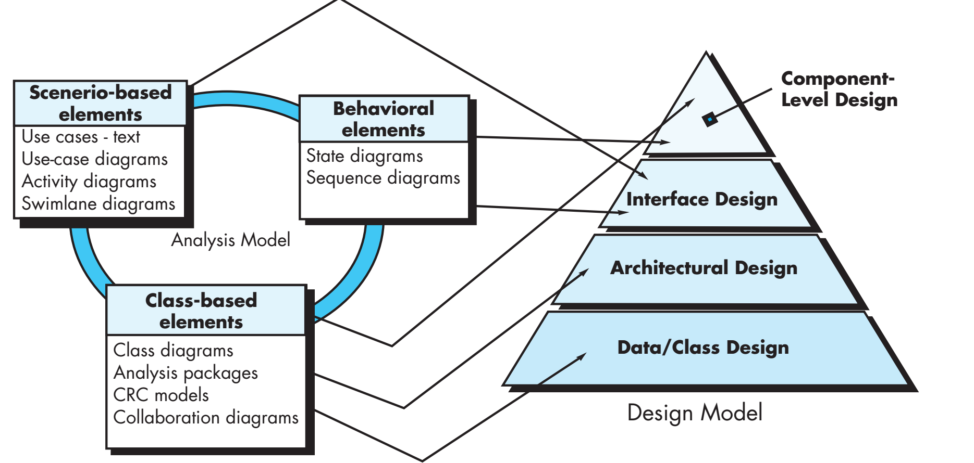
Translating the requirements model into the design model
This figure is brought from: “R.G. Pressman, B. R. Maxim, Software Engineering_ A Practitioner’s Approach, 8th Edition, 2014”.

Slide 14
Data/Class design
The data/class design transforms class models into design class realizations and the requisite data structures required to implement the software.
The objects and relationships defined in the CRC and the detailed data content depicted by class attributes and other notation provide the basis for the data design activity.
More detailed class design occurs as each software component is designed.
This slide is brought from: “R.G. Pressman, B. R. Maxim, Software Engineering_ A Practitioner’s Approach, 8th Edition, 2014”.

Slide 15
Architectural design
The architectural design defines the relationship between major structural elements of the software, the architectural styles and patterns that can be used to achieve the requirements defined for the system, and the constraints that affect the way in which architecture can be implemented.
This slide is brought from: “R.G. Pressman, B. R. Maxim, Software Engineering_ A Practitioner’s Approach, 8th Edition, 2014”.

Slide 16
Interface design
The interface design describes how the software communicates with systems that interoperate with it, and with humans who use it.
An interface implies a flow of information (e.g., data and/or control) and a specific type of behavior.
Therefore, usage scenarios and behavioral models provide much of the information required for interface design.
This slide is brought from: “R.G. Pressman, B. R. Maxim, Software Engineering_ A Practitioner’s Approach, 8th Edition, 2014”.

Slide 17
Component-level design
The component-level design transforms structural elements of the software architecture into a procedural description of software components.
Information obtained from the class-based models and behavioral models serve as the basis for component design.
This slide is brought from: “R.G. Pressman, B. R. Maxim, Software Engineering_ A Practitioner’s Approach, 8th Edition, 2014”.

Slide 18
The Design Process
Software design is an iterative process through which requirements are translated into a “blueprint” for constructing the software.
Initially, the blueprint depicts a holistic view of software. That is, the design is represented at a high level of abstraction—a level that can be directly traced to the specific system objective and more detailed data, functional, and behavioral requirements.
As design iterations occur, subsequent refinement leads to design representations at much lower levels of abstraction. These can still be traced to requirements, but the connection is more subtle.
This slide is brought from: “R.G. Pressman, B. R. Maxim, Software Engineering_ A Practitioner’s Approach, 8th Edition, 2014”.

Slide 19
Importance of Design in terms of quality
During design you make decisions that will ultimately affect the success of software construction.
The importance of software design can be stated with quality.
Design is the place where quality is fostered in software engineering.
Design provides you with representations of software that can be assessed for quality.
Design is the only way that you can accurately translate stakeholder’s requirements into a finished software product or system.
This slide is brought from: “R.G. Pressman, B. R. Maxim, Software Engineering_ A Practitioner’s Approach, 8th Edition, 2014”.

Slide 20
Importance of Design in terms of quality( Cnt’d)
Software design serves as the foundation for all the software engineering and software support activities that follow.
Without design, you risk building an unstable system—one that will fail when small changes are made; one that may be difficult to test; one whose quality cannot be assessed until late in the software process, when time is short and many dollars have already been spent.

Slide 21
Software Quality Guidelines and Attributes
Throughout the design process, the quality of the evolving design is assessed with a series of technical reviews.
Three characteristics that serve as a guide for the evaluation of a good design as follows.
The design should implement all of the explicit requirements contained in the requirements model, and it must accommodate all of the implicit requirements desired by stakeholders.
The design should be a readable, understandable guide for those who generate code and for those who test and subsequently support the software.
The design should provide a complete picture of the software, addressing the data, functional, and behavioral domains from an implementation perspective.
This slide is brought from: “R.G. Pressman, B. R. Maxim, Software Engineering_ A Practitioner’s Approach, 8th Edition, 2014”.

Slide 22
Assessing Design Quality—The Technical Review(TR)
A technical review is a meeting conducted by members of the software team.
Usually two, three, or four people participate depending on the scope of the design information to be reviewed.
When the meeting commences, the intent is to note all problems with the work product so that they can be corrected before implementation begins.
At the conclusion of the TR, the review team determines whether further actions are required on the part of the producer before the design work product can be approved as part of the final design model.
This slide is brought from: “R.G. Pressman, B. R. Maxim, Software Engineering_ A Practitioner’s Approach, 8th Edition, 2014”.

Slide 23
Quality Guidelines
A design should exhibit an architecture that
has been created using recognizable architectural styles or patterns,
is composed of components that exhibit good design characteristics,
can be implemented in an evolutionary fashion, thereby facilitating implementation and testing.
A design should be modular; that is, the software should be logically partitioned into elements or subsystems.
A design should contain distinct representations of data, architecture, interfaces, and components.
A design should lead to data structures that are appropriate for the classes to be implemented and are drawn from recognizable data patterns.
This slide is brought from: “R.G. Pressman, B. R. Maxim, Software Engineering_ A Practitioner’s Approach, 8th Edition, 2014”.

Slide 24
Quality Guidelines(Cnt’d)
A design should lead to components that exhibit independent functional characteristics.
A design should lead to interfaces that reduce the complexity of connections between components and with the external environment.
A design should be derived using a repeatable method that is driven by information obtained during software requirements analysis.
A design should be represented using a notation that effectively communicates its meaning.
This slide is brought from: “R.G. Pressman, B. R. Maxim, Software Engineering_ A Practitioner’s Approach, 8th Edition, 2014”.

Slide 25
Quality Attributes: FURPS
Functionality is assessed by evaluating the feature set and capabilities of the program, the generality of the functions that are delivered, and the security of the overall system.
Usability is assessed by considering human factors, overall aesthetics, consistency, and documentation.
Reliability is evaluated by measuring the frequency and severity of failure, the accuracy of output results, the mean-time-to-failure (MTTF), the ability to recover from failure, and the predictability of the program.
Performance is measured using processing speed, response time, resource consumption, throughput, and efficiency.
Supportability combines extensibility, adaptability, and serviceability. These three attributes represent a more common term, maintainability—and in addition, testability, compatibility, configurability (the ability to organize and control elements of the software configuration), the ease with which a system can be installed, and the ease with which problems can be localized.
This slide is brought from: “R.G. Pressman, B. R. Maxim, Software Engineering_ A Practitioner’s Approach, 8th Edition, 2014”.

Slide 26
Quality Attributes
Not every software quality attribute is weighted equally as the software design is developed.
One application may stress functionality with a special emphasis on security.
Another may demand performance with particular emphasis on processing speed.
A third might focus on reliability.
Regardless of the weighting, it is important to note that these quality attributes must be considered as design commences, not after the design is complete and construction has begun.
This slide is brought from: “R.G. Pressman, B. R. Maxim, Software Engineering_ A Practitioner’s Approach, 8th Edition, 2014”.

Slide 27
Design
Software design encompasses the set of concepts, principles and practices that lead to the development of a high-quality system or product.
Design concepts must be understood before the mechanics of design practice are applied.
Design principles establish an overriding philosophy that guides the design work you must perform.
Design practice itself leads to the creation of various representations of the software that serve as a guide for the construction activity that follows.
This slide is brought from: “R.G. Pressman, B. R. Maxim, Software Engineering_ A Practitioner’s Approach, 8th Edition, 2014”.

Slide 28
Design Concepts
Has evolved over the history of software engineering.
Each provides the software designer with a foundation from which more sophisticated design methods can be applied.
Each helps you define criteria that can be used to partition software into individual components, separate or data structure detail from a conceptual representation of the software, and establish uniform criteria that define the technical quality of a software design.
This slide is brought from: “R.G. Pressman, B. R. Maxim, Software Engineering_ A Practitioner’s Approach, 8th Edition, 2014”.

Slide 29
Design Concepts (Cnt’d)
M. A. Jackson once said: “The beginning of wisdom for a [software engineer] is to recognize the difference between getting a program to work, and getting it right.”
Fundamental software design concepts provide the necessary framework for “getting it right”.
This slide is brought from: “R.G. Pressman, B. R. Maxim, Software Engineering_ A Practitioner’s Approach, 8th Edition, 2014”.

Slide 30
1- Abstraction
When you consider a modular solution to any problem, many levels of abstraction can be posed.
At the highest level of abstraction, a solution is stated in broad terms using the language of the problem environment. At lower levels of abstraction, a more detailed description of the solution is provided. Finally, at the lowest level of abstraction, the solution is stated in a manner that can be directly implemented.
As different levels of abstraction are developed, you work to create both procedural and data abstractions.
This slide is brought from: “R.G. Pressman, B. R. Maxim, Software Engineering_ A Practitioner’s Approach, 8th Edition, 2014”.

Slide 31
Types of Abstraction (Cnt’d)
A procedural abstraction refers to a sequence of instructions that have a specific and limited function. The name of a procedural abstraction implies these functions, but specific details are suppressed. An example of a procedural abstraction would be the word open for a door. Open implies a long sequence of procedural steps (e.g., walk to the door, reach out and grasp knob, turn knob and pull door, step away from moving door, etc.).
A data abstraction is a named collection of data that describes a data object.
In the context of the procedural abstraction open, we can define a data abstraction called door. Like any data object, the data abstraction for door would encompass a set of attributes that describe the door (e.g., door type, swing direction, opening mechanism, weight, dimensions).
This slide is brought from: “R.G. Pressman, B. R. Maxim, Software Engineering_ A Practitioner’s Approach, 8th Edition, 2014”.

Slide 32
2- Architecture
The overall structure of the software and the ways in which that structure provides conceptual integrity for a system.
In its simplest form, architecture is the structure or organization of program components (modules), the manner in which these components interact, and the structure of data that are used by the components.
In a broader sense, components can be generalized to represent major system elements and their interactions.
This slide is brought from: “R.G. Pressman, B. R. Maxim, Software Engineering_ A Practitioner’s Approach, 8th Edition, 2014”.

Slide 33
2- Architecture (Cnt’d)
One goal of software design is to derive an architectural rendering of a system. This rendering serves as a framework from which more detailed design activities are conducted.
A set of properties that should be specified as part of an architectural design.
Structural properties define “the components of a system (e.g., modules, objects, filters) and the manner in which those components are packaged and interact with one another.”
Extra-functional properties address “how the design architecture achieves requirements for performance, capacity, reliability, security, adaptability, and other system characteristics.
Families of related systems “draw upon repeatable patterns that are commonly encountered in the design of families of similar systems.”
Given the specification of these properties, the architectural design can be represented using one or more of a number of different models.
This slide is brought from: “R.G. Pressman, B. R. Maxim, Software Engineering_ A Practitioner’s Approach, 8th Edition, 2014”.

Slide 34
3- Patterns
A pattern is a named nugget of insight which conveys the essence of a proven solution to a recurring problem within a certain context amidst competing concerns”.
A design pattern describes a design structure that solves a particular design problem within a specific context and amid “forces” that may have an impact on the manner in which the pattern is applied and used.
The intent of each design pattern is to provide a description that enables a designer to determine
(1) whether the pattern is applicable to the current work,
(2) whether the pattern can be reused and
(3) Whether the pattern can serve as a guide for developing a similar, but functionally or structurally different pattern.
This slide is brought from: “R.G. Pressman, B. R. Maxim, Software Engineering_ A Practitioner’s Approach, 8th Edition, 2014”.

Slide 35
Separation of Concerns
Separation of concerns is a design concept that suggests that any complex problem can be more easily handled if it is subdivided into pieces that can each be solved and/or optimized independently.
A concern is a feature or behavior that is specified as part of the requirements model for the software.
By separating concerns into smaller, and therefore more manageable pieces, a problem takes less effort and time to solve.
It follows that the perceived complexity of two problems when they are combined is often greater than the sum of the perceived complexity when each is taken separately.
This leads to a divide-and-conquer strategy—it’s easier to solve a complex problem when you break it into manageable pieces. This has important implications with regard to software modularity.
Separation of concerns is manifested in other related design concepts: modularity, aspects, functional independence, and refinement.
This slide is brought from: “R.G. Pressman, B. R. Maxim, Software Engineering_ A Practitioner’s Approach, 8th Edition, 2014”.

Slide 36
5- Modularity
Is the most common manifestation of separation of concerns.
Software is divided into separately named and addressable components, sometimes called modules, that are integrated to satisfy problem requirements.
It has been stated that “modularity is the single attribute of software that allows a program to be intellectually manageable” .
Monolithic software (i.e., a large program composed of a single module) cannot be easily grasped by a software engineer. The number of control paths, span of reference, number of variables, and overall complexity would make understanding close to impossible.
In almost all instances, you should break the design into many modules, hoping to make understanding easier and, as a consequence, reduce the cost required to build the software.
This slide is brought from: “R.G. Pressman, B. R. Maxim, Software Engineering_ A Practitioner’s Approach, 8th Edition, 2014”.

Slide 37
5- Modularity (Cnt’d)
Recalling our discussion of separation of concerns, it is possible to conclude that if you subdivide software indefinitely the effort required to develop it will become negligibly small!
Unfortunately, other forces come into play, causing this conclusion to be (sadly) invalid.
The effort (cost) to develop an individual software module does decrease as the total number of modules increases.
This slide is brought from: “R.G. Pressman, B. R. Maxim, Software Engineering_ A Practitioner’s Approach, 8th Edition, 2014”.

Slide 38
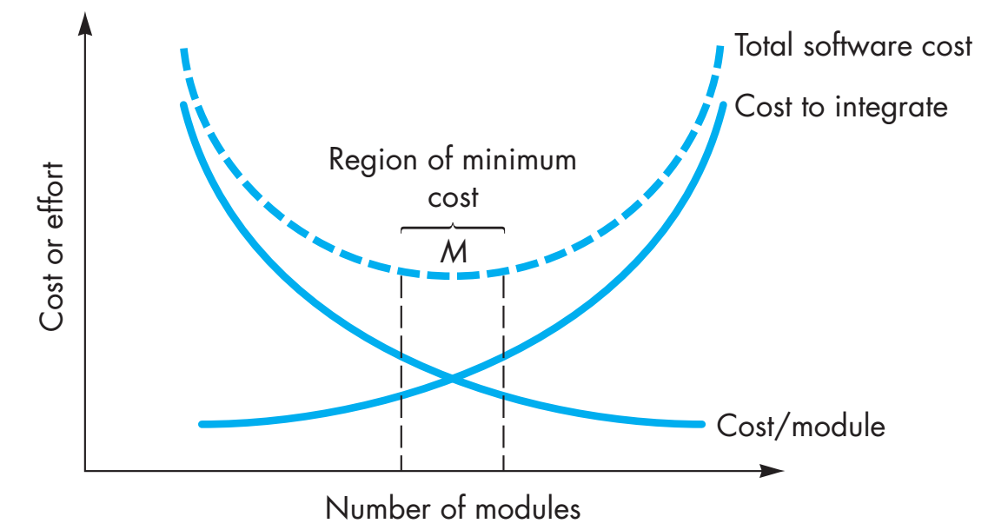
This figure is brought from: “R.G. Pressman, B. R. Maxim, Software Engineering_ A Practitioner’s Approach, 8th Edition, 2014”.

Slide 39
5- Modularity (Cnt’d)
Given the same set of requirements, more modules means smaller individual size. However, as the number of modules grows, the effort (cost) associated with integrating the modules also grows.
There is a number, M, of modules that would result in minimum development cost, but we do not have the necessary sophistication to predict M with assurance.
You should modularize, but care should be taken to stay in the vicinity of M.
Undermodularity or overmodularity should be avoided.
You modularize a design (and the resulting program) so that development can be more easily planned; software increments can be defined and delivered; changes can be more easily accommodated; testing and debugging can be conducted more efficiently, and long-term maintenance can be conducted without serious side effects.
This slide is brought from: “R.G. Pressman, B. R. Maxim, Software Engineering_ A Practitioner’s Approach, 8th Edition, 2014”.

Slide 40
The concept of modularity leads you to a fundamental question: “How do I decompose a software solution to obtain the best set of modules?”
This slide is brought from: “R.G. Pressman, B. R. Maxim, Software Engineering_ A Practitioner’s Approach, 8th Edition, 2014”.

Slide 41
6- Information Hiding
The principle of information hiding suggests that modules be “characterized by design decisions that (each) hides from all others.”
In other words, modules should be specified and designed so that information (algorithms and data) contained within a module is inaccessible to other modules that have no need for such information.
Hiding implies that effective modularity can be achieved by defining a set of independent modules that communicate with one another only that information necessary to achieve software function.
This slide is brought from: “R.G. Pressman, B. R. Maxim, Software Engineering_ A Practitioner’s Approach, 8th Edition, 2014”.

Slide 42
6- Information Hiding (Cnt’d)
Abstraction helps to define the procedural (or informational) entities that make up the software.
Hiding defines and enforces access constraints to both procedural detail within a module and any local data structure used by the module.
The use of information hiding as a design criterion for modular systems provides the greatest benefits when modifications are required during testing and later during software maintenance.
Because most data and procedural detail are hidden from other parts of the software, inadvertent errors introduced during modification are less likely to propagate to other locations within the software.
This slide is brought from: “R.G. Pressman, B. R. Maxim, Software Engineering_ A Practitioner’s Approach, 8th Edition, 2014”.

Slide 43
7- Functional Independence
Is a direct outgrowth of separation of concerns, modularity, and the concepts of abstraction and information hiding.
Is achieved by developing modules with “single minded” function and an “aversion” to excessive interaction with other modules.
You should design software so that each module addresses a specific subset of requirements and has a simple interface when viewed from other parts of the program structure.
It is fair to ask why independence is important. Software with effective modularity, that is, independent modules, is easier to develop because function can be compartmentalized and interfaces are simplified.
Independent modules are easier to maintain (and test) because secondary effects caused by design or code modification are limited, error propagation is reduced, and reusable modules are possible.
To summarize, functional independence is a key to good design, and design is the key to software quality.
This slide is brought from: “R.G. Pressman, B. R. Maxim, Software Engineering_ A Practitioner’s Approach, 8th Edition, 2014”.

Slide 44
7- Functional Independence (Cnt’d)
Independence is assessed using two qualitative criteria: cohesion and coupling. Cohesion is an indication of the relative functional strength of a module. Coupling is an indication of the relative interdependence among modules.
Cohesion is a natural extension of the information-hiding concept. A cohesive module performs a single task, requiring little interaction with other components in other parts of a program. Stated simply, a cohesive module should (ideally) do just one thing. Although you should always strive for high cohesion (i.e., single-mindedness), it is often necessary and advisable to have a software component perform multiple functions. However, “schizophrenic” components (modules that perform many unrelated functions) are to be avoided if a good design is to be achieved.
Coupling is an indication of interconnection among modules in a software structure. Coupling depends on the interface complexity between modules, the point at which entry or reference is made to a module, and what data pass across the interface. In software design, you should strive for the lowest possible coupling. Simple connectivity among modules results in software that is easier to understand and less prone to a “ripple effect”, caused when errors occur at one location and propagate throughout a system.
This slide is brought from: “R.G. Pressman, B. R. Maxim, Software Engineering_ A Practitioner’s Approach, 8th Edition, 2014”.

Slide 45
8-Refinement
Is a top-down design strategy.
An application is developed by successively refining levels of procedural detail.
A hierarchy is developed by decomposing a macroscopic statement of function (a procedural abstraction) in a stepwise fashion until programming language statements are reached.
Refinement is actually a process of elaboration. You begin with a statement of function (or description of information) that is defined at a high level of abstraction. That is, the statement describes function or information conceptually but provides no indication of the internal workings of the function or the internal structure of the information. You then elaborate on the original statement, providing more and more detail as each successive refinement (elaboration) occurs.
This slide is brought from: “R.G. Pressman, B. R. Maxim, Software Engineering_ A Practitioner’s Approach, 8th Edition, 2014”.

Slide 46
Abstraction and refinement are complementary concepts.
Abstraction enables you to specify procedure and data internally but suppress the need for “outsiders” to have knowledge of low-level details.
Refinement helps you to reveal low-level details as design progresses.
Both concepts allow you to create a complete design model as the design evolves.
This slide is brought from: “R.G. Pressman, B. R. Maxim, Software Engineering_ A Practitioner’s Approach, 8th Edition, 2014”.

Slide 47
9- Aspects
As requirements analysis occurs, a set of “concerns” is uncovered. These concerns “include requirements, use cases, features, data structures, quality-of-service issues, variants, intellectual property boundaries, collaborations, patterns and contracts”.
Ideally, a requirements model can be organized in a way that allows you to isolate each concern (requirement) so that it can be considered independently.
In practice, however, some of these concerns span the entire system and cannot be easily compartmentalized.
As design begins, requirements are refined into a modular design representation.
This slide is brought from: “R.G. Pressman, B. R. Maxim, Software Engineering_ A Practitioner’s Approach, 8th Edition, 2014”.

Slide 48
9- Aspects (Cnt’d)
Consider two requirements, A and B. Requirement B crosscuts requirement A “if a software decomposition [refinement] has been chosen in which A cannot be satisfied without taking B into account”.
As design refinement occurs, A* is a design representation for requirement A and B* is a design representation for requirement B. Therefore, A* and B* are representations of concerns, and B* crosscuts A*.
An aspect is a representation of a crosscutting concern. Therefore, the design representation, B*, is an aspect of the system.
In an ideal context, an aspect is implemented as a separate module (component) rather than as software fragments that are “scattered” or “tangled” throughout many components. To accomplish this, the design architecture should support a mechanism for defining an aspect—a module that enables the concern to be implemented across all other concerns that it crosscuts.
This slide is brought from: “R.G. Pressman, B. R. Maxim, Software Engineering_ A Practitioner’s Approach, 8th Edition, 2014”.

Slide 49
10- Refactoring
Is a reorganization technique that simplifies the design (or code) of a component without changing its function or behavior.
Is the process of changing a software system in such a way that it does not alter the external behavior of the code [design] yet improves its internal structure.”
When software is refactored, the existing design is examined for redundancy, unused design elements, inefficient or unnecessary algorithms, poorly constructed or inappropriate data structures, or any other design failure that can be corrected to yield a better design.
For example, a first design iteration might yield a component that exhibits low cohesion (i.e., it performs three functions that have only limited relationship to one another). After careful consideration, you may decide that the component should be refactored into three separate components, each exhibiting high cohesion. The result will be software that is easier to integrate, easier to test, and easier to maintain.
Although the intent of refactoring is to modify the code in a manner that does not alter its external behavior, inadvertent side effects can and do occur.
This slide is brought from: “R.G. Pressman, B. R. Maxim, Software Engineering_ A Practitioner’s Approach, 8th Edition, 2014”.

Slide 50
11- Design Classes
The analysis model defines a set of analysis classes. Each of these classes describes some element of the problem domain, focusing on aspects of the problem that are user visible. The level of abstraction of an analysis class is relatively high.
As the design model evolves, you will define a set of design classes that refine the analysis classes by providing design detail that will enable the classes to be implemented, and implement a software infrastructure that supports the business solution.
This slide is brought from: “R.G. Pressman, B. R. Maxim, Software Engineering_ A Practitioner’s Approach, 8th Edition, 2014”.

Slide 51
Characteristics of a good class
Complete and sufficient. A design class should be the complete encapsulation of all attributes and methods that can reasonably be expected (based on a knowledgeable interpretation of the class name) to exist for the class. Sufficiency ensures that the design class contains only those methods that are sufficient to achieve the intent of the class, no more and no less.
Primitiveness. Methods associated with a design class should be focused on accomplishing one service for the class. Once the service has been implemented with a method, the class should not provide another way to accomplish the same thing.
This slide is brought from: “R.G. Pressman, B. R. Maxim, Software Engineering_ A Practitioner’s Approach, 8th Edition, 2014”.

Slide 52
Characteristics of a good class(Cnt’d)
High cohesion. A cohesive design class has a small, focused set of responsibilities and single-mindedly applies attributes and methods to implement those responsibilities.
Low coupling. Within the design model, it is necessary for design classes to collaborate with one another. However, collaboration should be kept to an acceptable minimum.
If a design model is highly coupled (all design classes collaborate with all other design classes), the system is difficult to implement, to test, and to maintain over time.
In general, design classes within a subsystem should have only limited knowledge of other classes.
This slide is brought from: “R.G. Pressman, B. R. Maxim, Software Engineering_ A Practitioner’s Approach, 8th Edition, 2014”.

Slide 53
Cohesion
Refers to how single-minded a module (class, object, or method) is within a system. A class or object should represent only one thing, and a method should solve only a single task.
Method cohesion addresses the cohesion within an individual method. Methods should do one and only one thing.
Class cohesion is the level of cohesion among the attributes and methods of a class. A class should represent only one thing.

Slide 54
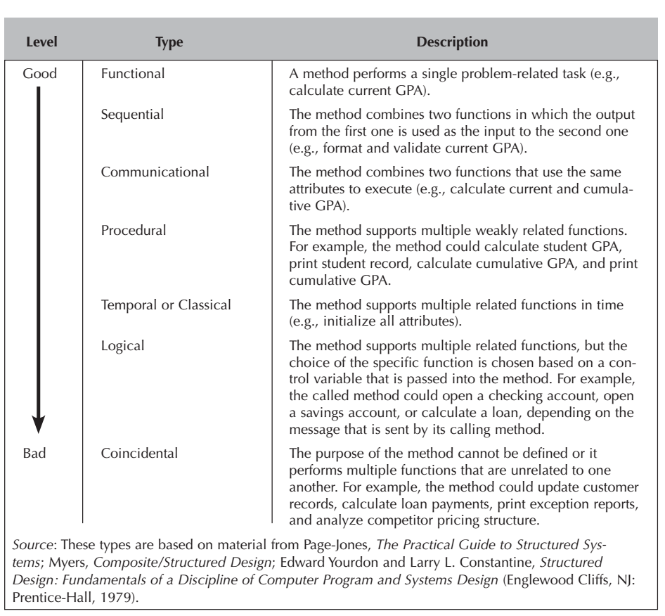
Types of method cohesion

Slide 55
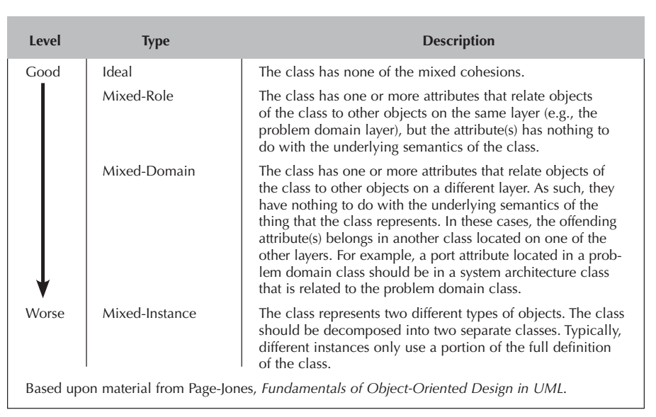
Types of class cohesion

Slide 56
Coupling
Refers to how interdependent or interrelated the modules (classes, objects, and methods) are in a system.
The higher the interdependency, the more likely changes in part of a design can cause changes to be required in other parts of the design.
Interaction coupling deals with the coupling among methods and objects through message passing.
Inheritance coupling, deals with how tightly coupled the classes are in an inheritance hierarchy.

Slide 57
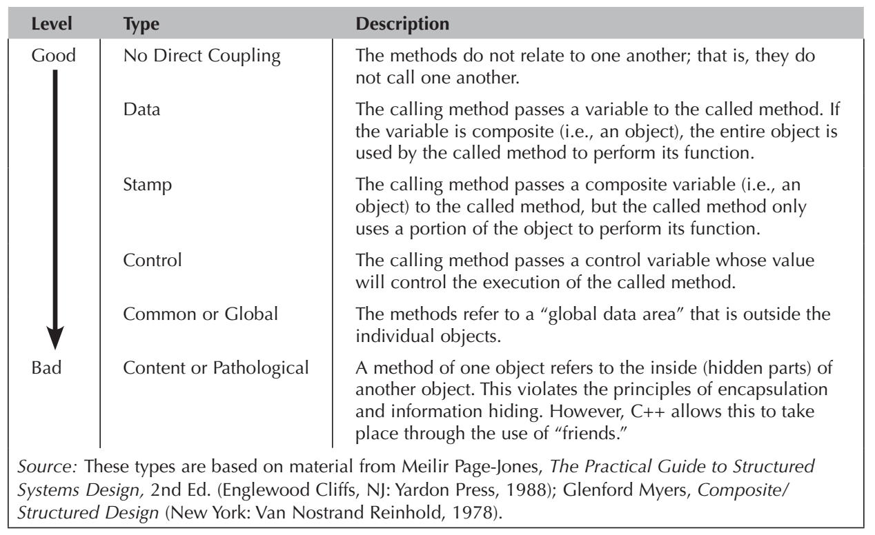
Types of interaction coupling

Slide 58
12- Design for Test
There is an ongoing chicken-and-egg debate about whether software design or test case design should come first.
Advocates of test-driven development (TDD) write tests before implementing any other code.
“Test fast, fail fast, adjust fast.”
This slide is brought from: “R.G. Pressman, B. R. Maxim, Software Engineering_ A Practitioner’s Approach, 8th Edition, 2014”.

Slide 59
Evolve problem domain-oriented analysis models into optimal solution domain-oriented design models
Object-oriented systems development is both incremental and iterative.
In this time we begin looking at the models of the problem domain through a design lens.
In this step, we make modifications to the problem domain models that will enhance the efficiency and effectiveness of the evolving system.
Factoring,
Partitions and collaborations,
Layers

Slide 60
Factoring
Is the process of separating out a module into a stand-alone module. The new module can be a new class or a new method. For example, when reviewing a set of classes, it may be discovered that they have a similar set of attributes and methods. Thus, it might make sense to factor out the similarities into a separate class.

Slide 61
Partitions and Collaborations
The actual size of the system representation can overload the user and the developer. At this point in the evolution of the system, it might make sense to split the representation into a set of partitions.
A partition is the object-oriented equivalent of a subsystem, where a subsystem is a decomposition of a larger system into its component systems.
From an object- oriented perspective, partitions are based on the pattern of activity (messages sent) among the objects in an object-oriented system.

Slide 62
Partitions and Collaborations(Cnt’d)
A good place to look for potential partitions is the collaborations modeled in UML’s communication diagrams.
One useful way to identify collaborations is to create a communication diagram for each use case. However, because an individual class can support multiple use cases, an individual class can participate in multiple use-case-based collaborations. In cases where classes are supporting multiple use cases, the collaborations should be merged.
The class diagram should be reviewed to see how the different classes are related to one another.
The greater the coupling between classes, the more likely the classes should be grouped together in a collaboration or partition.

Slide 63
The general rule
The more messages sent between objects, the more likely the objects belong in the same partition.
The fewer messages sent, the less likely the two objects belong together.

Slide 64
Another useful approach to identifying potential partitions
Model each collaboration between objects in terms of clients, servers, and contracts.
A client is an instance of a class that sends a message to an instance of another class for a method to be executed;
A server is the instance of a class that receives the message;
Contract is the specification that formalizes the interactions between the client and server objects.
Allows the developer to build up potential partitions by looking at the contracts that have been specified between objects.
The more contracts there are between objects, the more likely that the objects belong in the same partition. The fewer contracts, the less chance there is that the two classes belong in the same partition.

Slide 65
Reference
Dennis, Wixon, Tegarden, “System Analysis and Design, An Object Oriented Approach with UML”, 5th Edition, 2015.
R. G. Pressman, B. R. Maxim, Software Engineering_ A Practitioner’s Approach, 8th Edition, 2014.

